Slide 1


Plant Disease Prediction
For Sustainable Agriculture
Student ID
INTERNSHIP_1736246007677d02f700dbe

Slide 2

Learning Objectives
Python Programming Language
(CNN Model)
Importing dataset into program
Importing different libraries and implementing
Training of data
Validation of data
Testing of data
Creating graph on Training and Validation accuracy
(Plant Disease Prediction App)
Importing libraries and model
Creating app Home page and Disease Prediction page
Allowing user input to accept images
Using classes from dataset to predict disease
Using Streamlit to execute app
GOAL
Source :
www.freepik.com/

Slide 3
Tools and Technology used
Google Collab for creating CNN Model
Dataset from Kaggle
GitHub for reference and data
Visual Studio Code for creating app
Streamlit for executing app
Python for programming and app creation
Jupyter Notebook for interactive environment

Slide 4
Methodology
Importing dataset from Kaggle
Importing libraries
Training, Validation & Testing of dataset
Creating Graph and evaluating Accuracy & Loss
Completion of model
Importing the model and libraries in Python app
Loading and preprocessing the image
Creating app Dashboard, Home page and Disease Prediction page
Using Streamlit and local hosting the app

Slide 5
Problem Statement:
Plant diseases significantly impact global food production, leading to reduced crop yield, economic losses, and food insecurity.
Traditional disease detection methods rely on manual inspection, which is often time-consuming, labor-intensive, and prone to human error.
Delayed identification of diseases results in uncontrolled spread, excessive pesticide use, and environmental damage.

Slide 6
Solution:
To address these challenges, an AI-powered plant disease prediction system can be developed using machine learning technologies.
By analyzing plant images and environmental data, the system can accurately detect diseases at an early stage, providing real-time alerts and actionable insights.
This solution will help farmers make data-driven decisions, reduce unnecessary pesticide use, improve crop health, and promote sustainable agricultural practices, ultimately increasing productivity and food security.

Slide 7
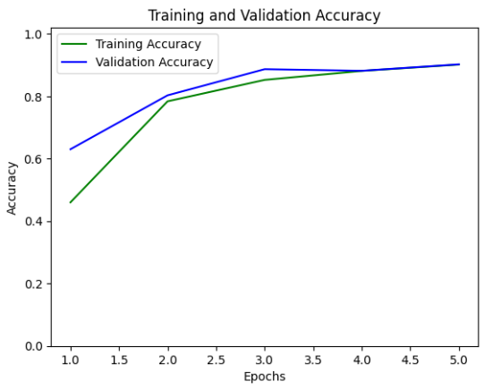
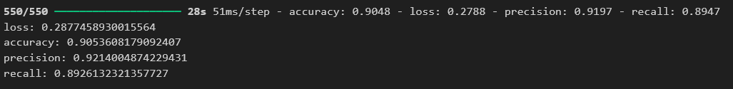
Screenshot of Output:

Slide 8
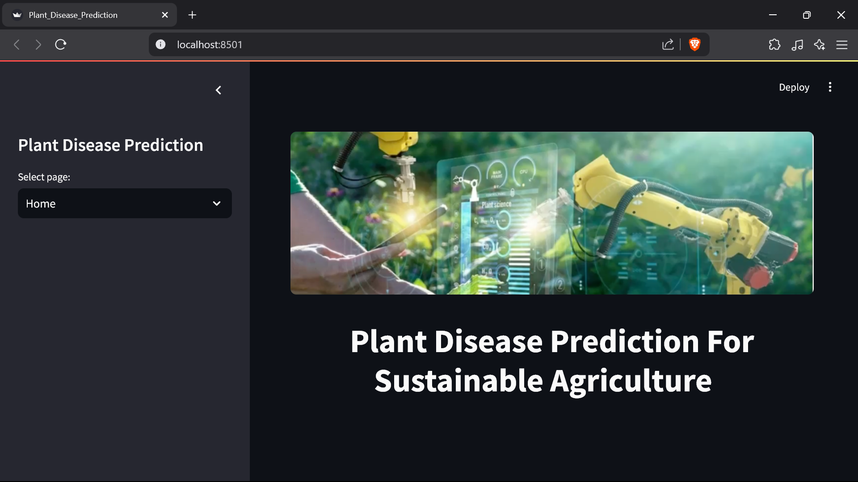
Screenshot of Output:

Slide 9
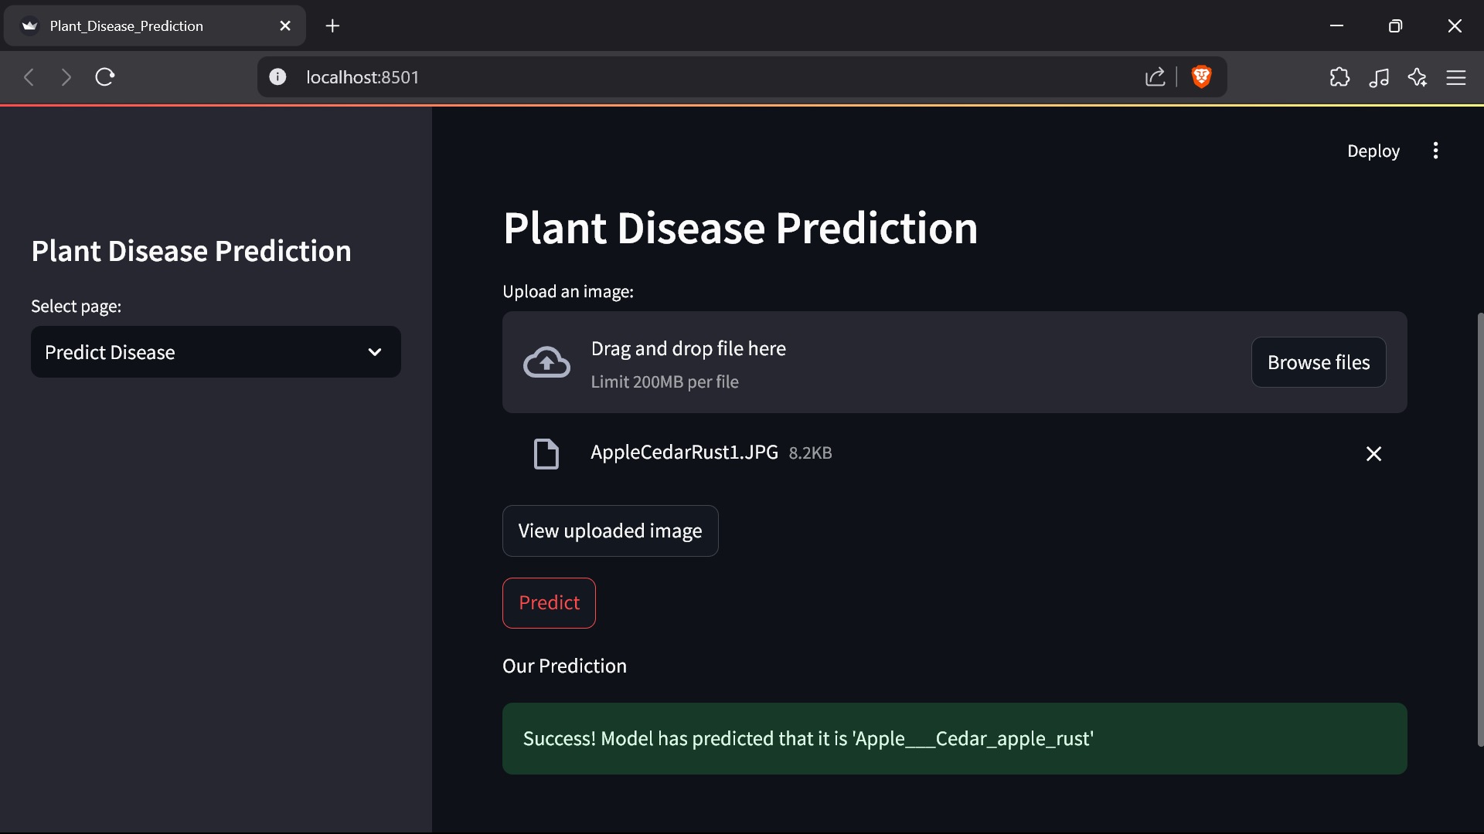
Screenshot of Output:

Slide 10
Conclusion:
We developed a Plant Disease Prediction System based on CNN model to accurately identify plant diseases based on a 38-class dataset.
This AI-driven approach enables early detection of diseases, helping farmers take timely action to protect their crops.
By providing precise and automated disease identification, the model minimizes reliance on excessive pesticides, improves crop health, and supports sustainable agricultural practices.
This solution empowers farmers with data-driven insights, leading to increased productivity, reduced losses, and a more resilient food supply chain.
Link to my GitHub:
https://github.com/mananvernekar07/PlantDiseaseClassification_AIML.git

